Slide 1
Unemployment: Pakistan vs Bangladesh
Muhammad Taha Khan 1747180
Murtaza Ahmed Butt 1747185
Hamza Sabahat 1747164

Slide 2
Introduction
Pakistan
Bangladesh
Unemployment
Type of unemployment

Slide 3
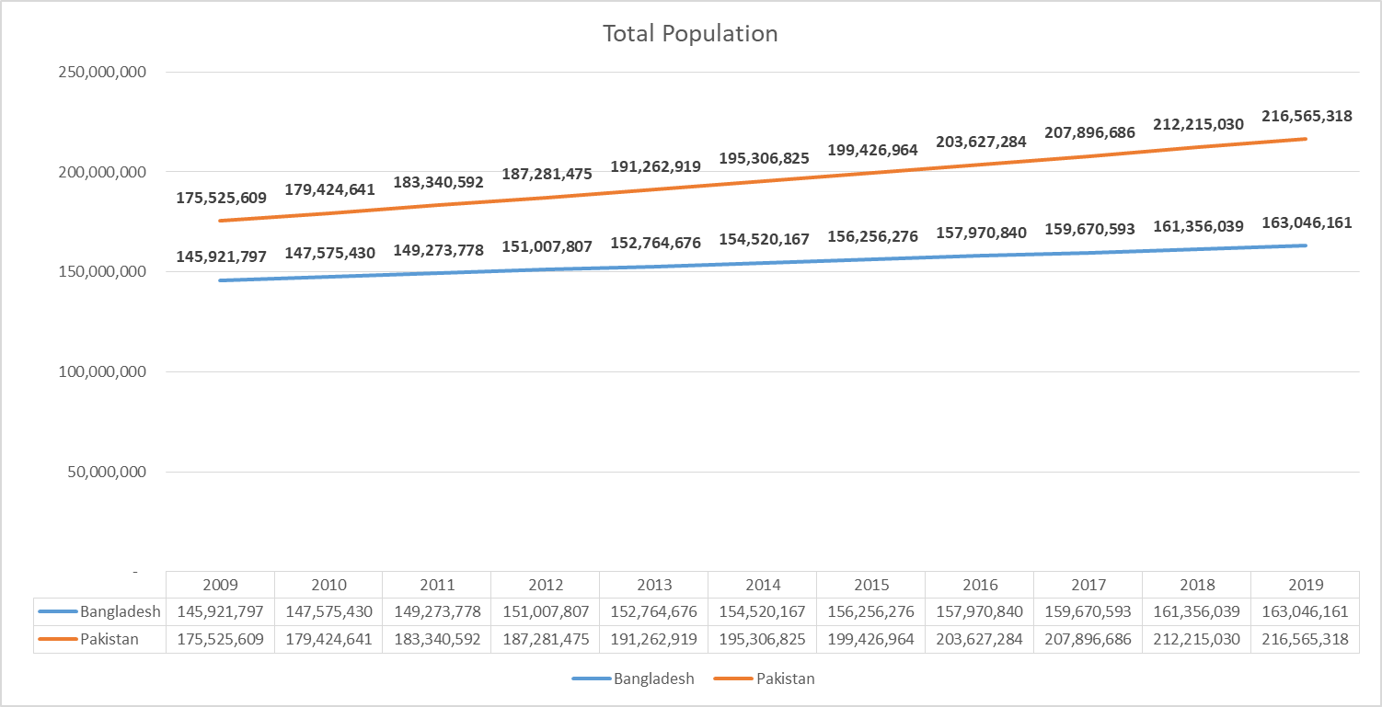
Total Population
Bangladesh Average growth 1.12%
Pakistan Average growth 2.12%

Slide 4
Population distribution
Reasons for high population in Rural areas.
Agriculture based countries.
Second highest source of income is from Agriculture.
Lack of family planning .
Description | Ruler(2019) | Urban(2019)
Pakistan | 63.09 | 36.91%
Bangladesh | 62.595% | 37.405%

Slide 5
Labor Force
Less influence of women in labor market.
Very low industrial growth.
High Population Growth.
8.1% Growth rate in 2019
Tertiary sector contributing 52.8% in GDP
Skilled Labor Force

Slide 6
Literacy Rate 2019
Literacy
Meaning of literacy in Pakistan
Perception of Male in the family is to be the breadwinner.
People living below poverty line.
Poor Education in Public Sector and Expensive quality of education in private sector.

Slide 7
Literacy Rate 2011
Literacy
High Budget allocation in education sector.
Ensure good quality of education is being provided
Meaning of literacy in Bangladesh
73.9% literate Population in 2020.

Slide 8
Employed and Unemployed Labor force in Pakistan

Slide 9
Employed and Unemployed Labor force in Bangladesh

Slide 10
Summary
Bangladesh
vs
Pakistan
Future Job opportunities
Industrial Growth
UNESCO and the Government of Pakistan
The prime minster educational portal
Promote women education
Introduce awareness campaigns to control population
Incentives to different sector to sustain educated Population.
Conclusion
Recommendation

Slide 11


